Slide 1
A Review of the Course
Geoff Hulten

Slide 2
Machine Learning Algorithms
Tens of thousands of machine learning algorithms, hundreds new every year
Types of Machine Learning Algorithms:
Supervised (inductive) learning Training data includes desired outputs
Unsupervised learning Training data does not include desired outputs
Semi-supervised learning Training data includes a few desired outputs
Reinforcement learning Rewards from sequence of actions

Slide 3
Roles in Machine Learning
Machine Learning Researcher
Develop new algorithms
Explore cutting edge problems
Advance human knowledge
Machine Learning Practitioner
Understanding domain, prior knowledge, and goals
Data integration, selection, cleaning, pre-processing, etc.
Build effective models
Interpret results
Iterate and iterate and iterate…
Machine learning engineer
Integrate machine learning models into production systems
Connect machine learning with users
User experience
Telemetry
Implement Inference systems
Make everything work…
Data scientist
Organize, understand, & make data actionable
Answer questions from data
Lots of cross over with machine learning practitioner

Slide 4
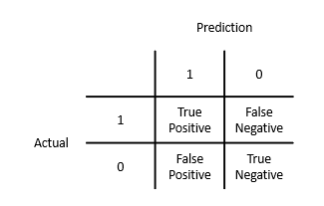
Basic Evaluation Metrics
Actual | Prediction
0 | 1
0 | 1
0 | 1
0 | 0
0 | 0
1 | 0
1 | 0
1 | 1
1 | 1
1 | 1
Accuracy: What fraction does it get right
(# TP + # TN) / # Total
Precision: When it says 1 how often is it right
# TP / (# TP + # FP)
Recall: What fraction of 1s does it get right
# TP / (# TP + # FN)
False Positive Rate: What fraction of 0s are called 1s
# FP / (# FP + # TN)
False Negative Rate: What fraction of 1s are called 0s
# FN / (# TP + # FN)
3
2
3
2

Slide 5
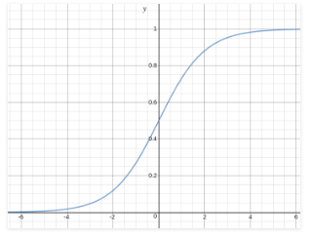
Structure of Logistic Regression
$y^{^}=sigmoid(w_{0}+ \sum_{i}^{n}{w_{i} ∗ x_{i})}$
$sigmoid\left(x\right)= \frac{1}{1+ e^{−x}}$
Threshold
Predict 0
Predict 1
Example:
W0 | W1 | W2
.25 | -1 | 1
X1 | X2
1 | 1
1 | 0
0 | 1
0 | 0

Slide 6
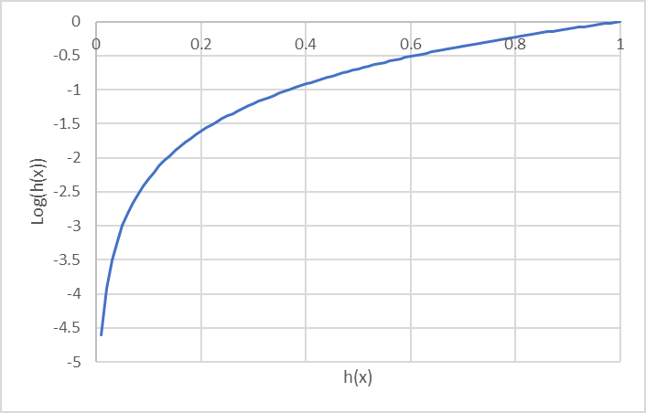
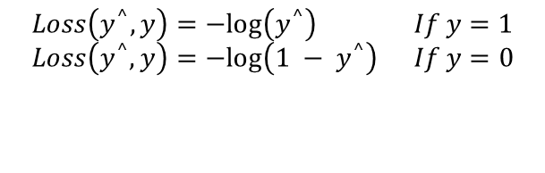
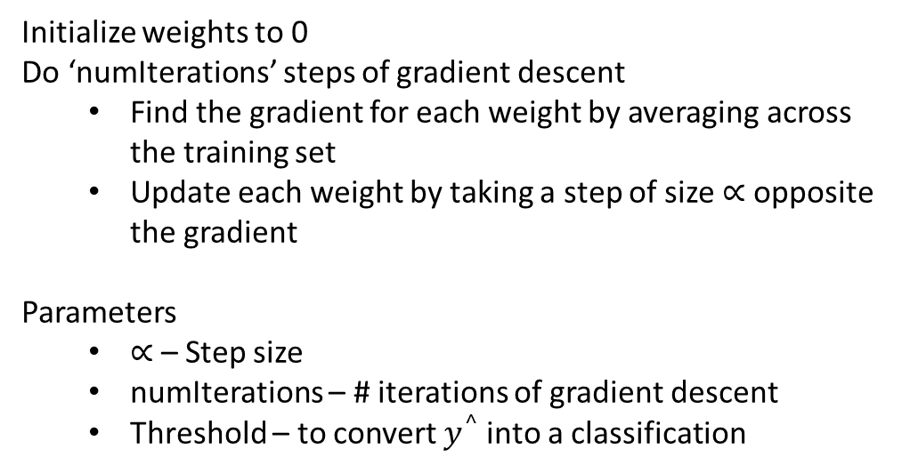
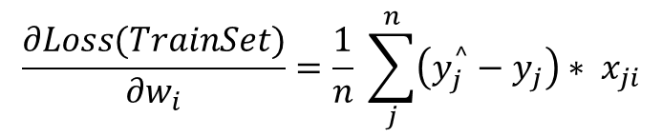
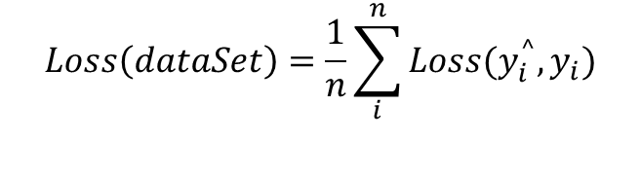
Logistic Regression – Loss and Optimization
Loss
Optimization
$$Loss\left(y^{^},y\right)=−log\left(y^{^}\right) If y=1$$
$$Loss\left(y^{^},y\right)=−log\left(1 − y^{^}\right) If y=0$$
$$\frac{∂Loss(TrainSet)}{∂w_{i}}=\frac{1}{n} \sum_{j}^{n}{\left(y_{j}^{^}−y_{j}\right)∗ x_{ji}}$$
Initialize weights to 0
Do ‘numIterations’ steps of gradient descent
Find the gradient for each weight by averaging across the training set
Update each weight by taking a step of size $∝$ opposite the gradient
Parameters
$∝$ – Step size
numIterations – # iterations of gradient descent
Threshold – to convert $y^{^}$into a classification
$$Loss\left(dataSet\right)=\frac{1}{n}\sum_{i}^{n}{Loss(y_{i}^{^},y_{i})}$$

Slide 7
Basic Feature Types
Binary Features
ContainsWord(call)?
IsLongSMSMessage?
Contains(*#)?
ContainsPunctuation?
Categorical Features
FirstWordPOS ->
{ Verb, Noun, Other }
MessageLength ->
{ Short, Medium, Long, VeryLong }
TokenType ->
{ Number, URL, Word, Phone#, Unknown }
GrammarAnalysis ->
{ Fragment, SimpleSentence, ComplexSentence }
Numeric Features
CountOfWord(call)
MessageLength
FirstNumberInMessage
WritingGradeLevel

Slide 8
Feature Engineering for Text
Tokenizing
Bag of Words
N-grams
TF-IDF
Embeddings
NLP

Slide 9
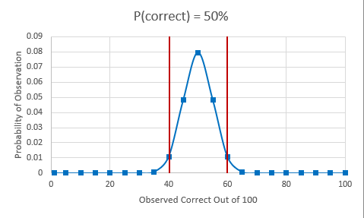
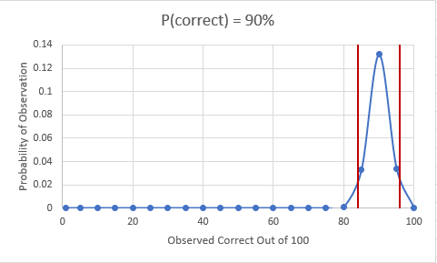
Confidence Intervals
Upper = $Accuracy+ Z_{N}∗σ_{Accuracy}$
Lower = $Accuracy − Z_{N}∗σ_{Accuracy}$
Confidence | 95% | 98% | 99%
$$Z_{N}$$ | 1.96 | 2.33 | 2.58

Slide 10
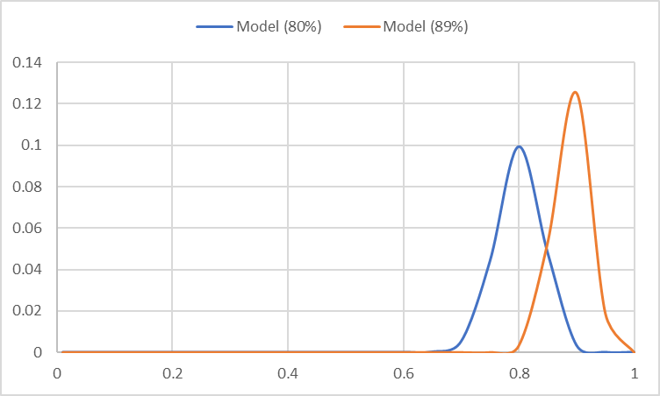
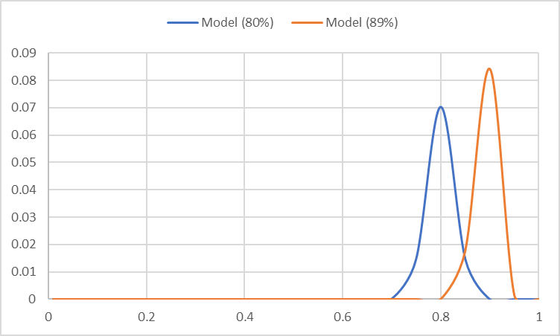
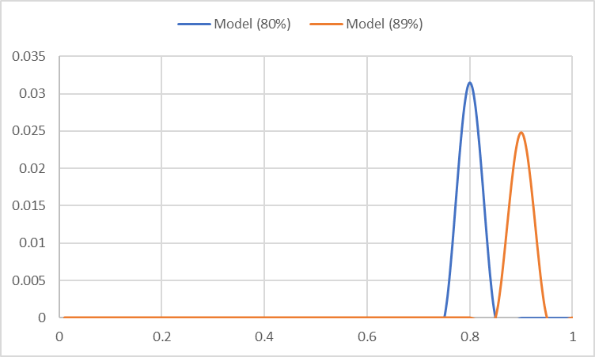
Comparing Models using Confidence Intervals
IF: Model1 – Bound > Model2 + Bound
Samples | Model(89%) – Bound | Model(80%) + Bound
100 | 82.9% | 87.8%
200 | 84.7% | 85.5%
1000 | 87.0% | 82.5%
95% Confidence Interval

Slide 11
Cross Validation
Instead of dividing training data into two parts (train & validation).
Divide it into K parts and loop over them
Hold out one part for validation, train on remaining data
K = 1
K = 2
K = 3
K = 4
K = 5
Train on
Validate on
$${Accuracy}_{CV}=\frac{1}{n} \sum_{k}{{Correct}_{k}}$$
$$σ_{{Accuracy}_{CV}}≈ \sqrt{\frac{{Accuracy}_{CV}(1 −{Accuracy}_{CV})}{n}}$$

Slide 12
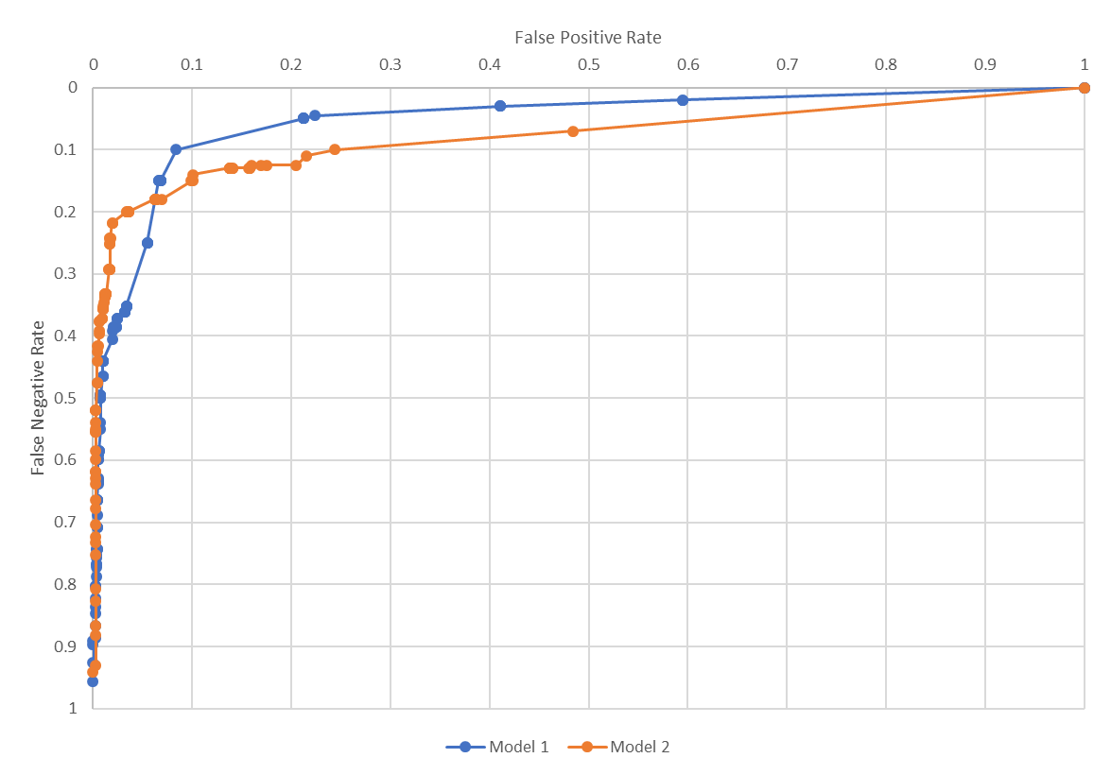
ROC Comparisons

Slide 13
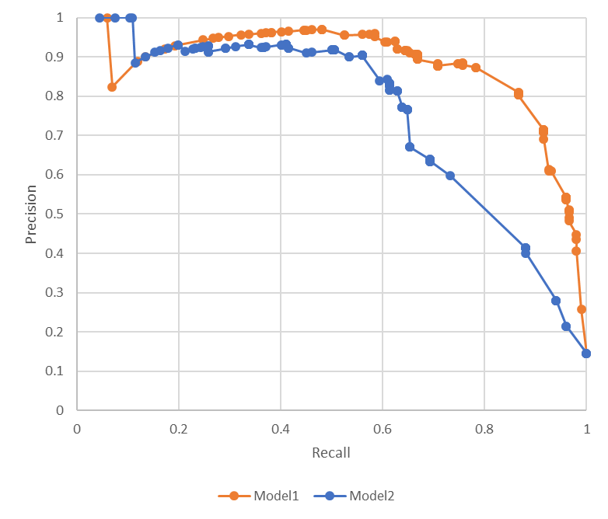
Precision Recall Curves – PR Curves
Incremental Classifications More Accurate
Everything Classified Correctly
Incremental Classifications
Less Accurate
First Set of Mistakes
Everything Classified as 1

Slide 14
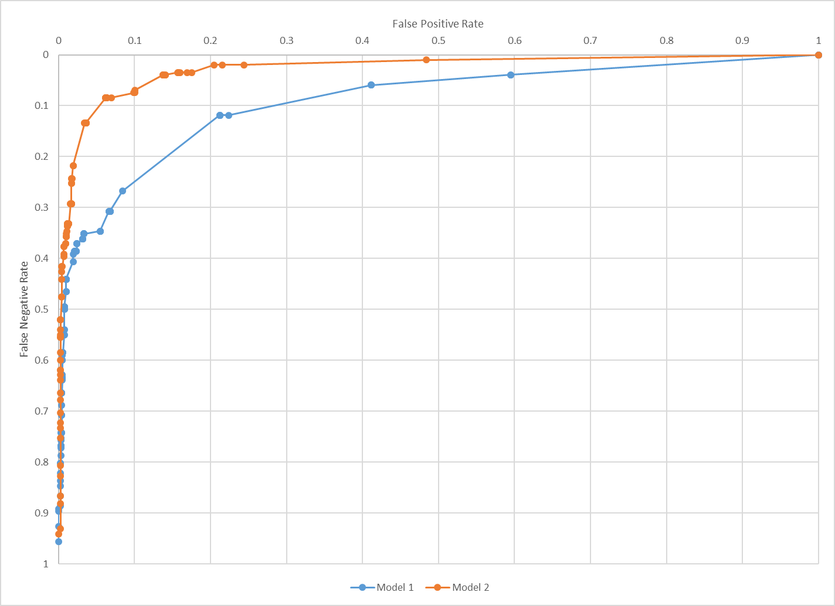
Operating Points
Balance Mistakes for your Application
Spam needs low FP Rate
Use separate hold out data to find threshold

Slide 15
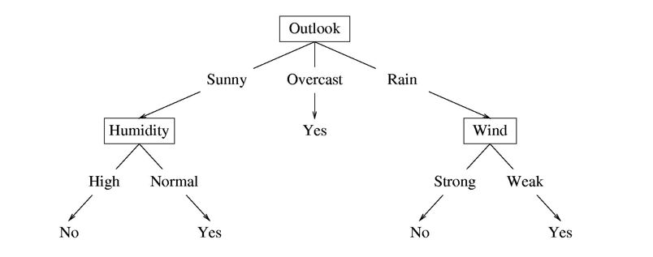
Structure of a Decision Tree
Internal nodes test feature values
One child per possible outcome
Leaves contain predictions
Humidity | Outlook | Wind | Prediction
Normal | Rain | Strong
High | Sunny | Normal

Slide 16








Decision Trees: Basics
Internal Nodes
Leaves
Binary Feature
Categorical Feature
Numeric Feature
$$x_{i}=0?$$
Classification
Regression
Probability Estimate
$$y=1$$
False
True
$$x_{i}?$$
$$y=101.2$$
$${Value}_{1}$$
$${Value}_{n}$$
…
$$p\left(y=0\right)= .3$$
$$p\left(y=1\right)= .3$$
$$p\left(y=2\right)= .4$$
$$x_{i}<101.2?$$
False
True

Slide 17
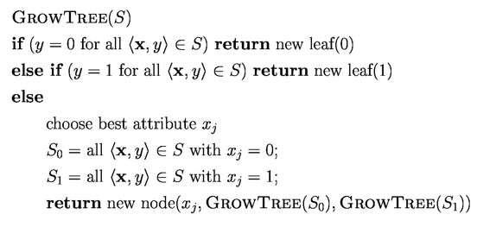
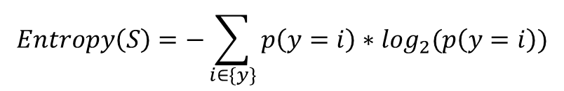
Decision Tree Optimization
Loss(S, $x_{i}$)
lossSum = 0
for $S_{val}$ in SplitByFeatureValues(S, $x_{i}$)
lossSum += Entropy($S_{val}$ ) * len($S_{val}$)
return lossSum / len(S)
InformationGain(S, $x_{i}$)
return Entropy(S) – Loss(S, $x_{i}$)
BestSplitAtribute(S)
informationGains = {}
for i in range(# features):
informationGains[i] = InformationGain(S, i)
if AllEqualZero(informationGains):
return <NONE>
return FindIndexWithHighestValue(informationGains)
$$Entropy\left(S\right)=−\sum_{i∈\{y\}}{p\left(y=i\right)∗\log_{2}(p\left(y=i\right))}$$

Slide 18
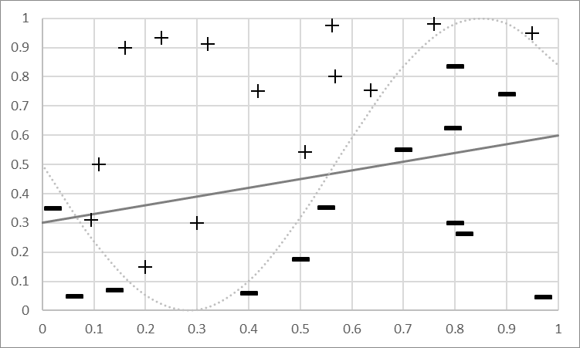
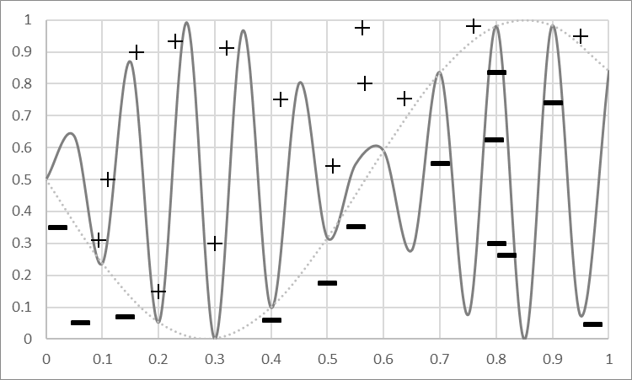
Bias and Variance
Bias Mistakes
Model Predicts +
Bias –
error caused because the model can not represent the concept
Variance –
error caused because the learning algorithm overreacts to small changes (noise) in the training data
TotalLoss = Bias + Variance (+ noise)
Model Predicts -
Model
Predicts +
Model Predicts -

Slide 19
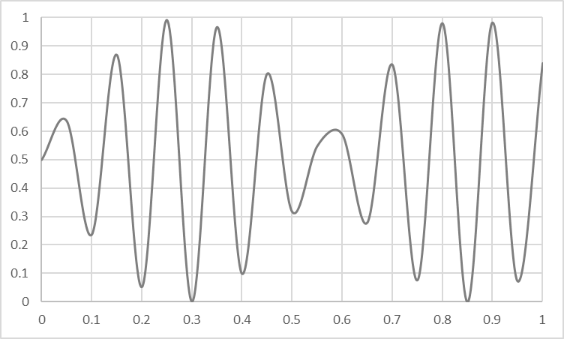
Overfitting vs Underfitting
Overfitting
Underfitting
Fitting the data too well
Features are noisy / uncorrelated to concept
Modeling process very sensitive (powerful)
Too much search
Learning too little of the true concept
Features don’t capture concept
Too much bias in model
Too little search to fit model

Slide 20
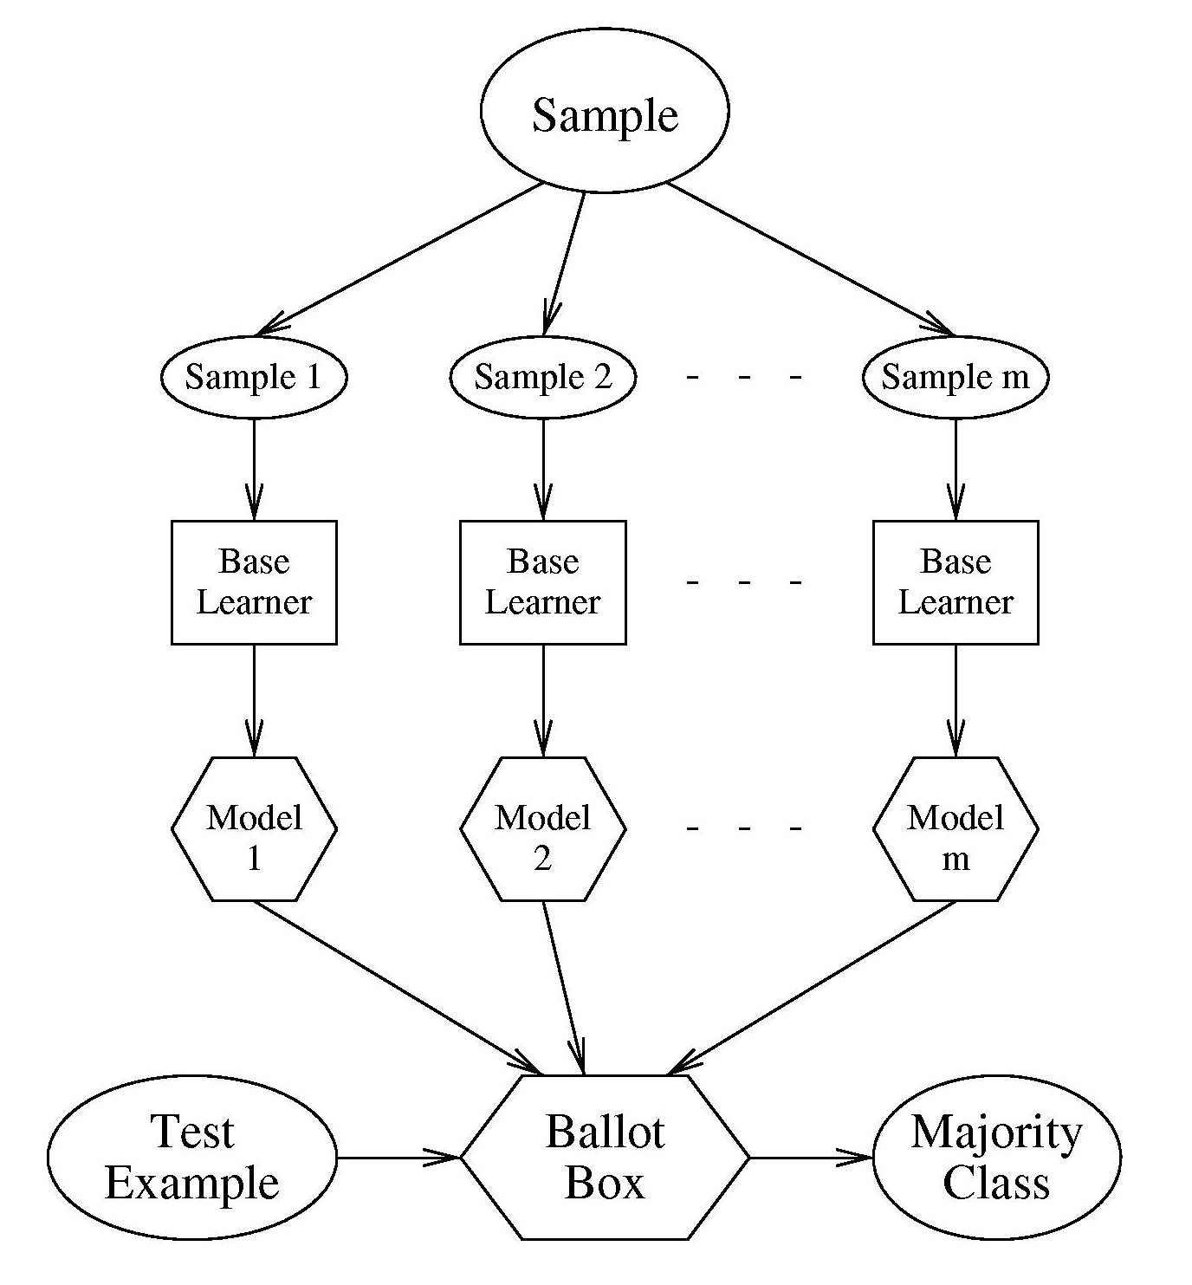
Bagging
Generate K training sets by sampling from the original training set
“Bootstrap” sample
Training set contains N training examples
Each of the K training sets also contains N training examples
Created by sampling with replacement from the original
Learn one model on each of the K training sets
Combine their predictions by uniform voting

Slide 21
Random Forests
Build N trees
Bootstrap sample for each training set (Bagging)
Restrict the features each tree can use
Combine by uniform voting

Slide 22
Example RandomForest Predict
$$x_{1}=1?$$
False
True
$$x_{2}=1?$$
False
True
$$x_{1}$$ | $$x_{2}$$ | $$x_{3}$$ | $$y$$
0 | 0 | 0
0 | 0 | 1
0 | 1 | 0
0 | 1 | 1
1 | 0 | 0
1 | 0 | 1
1 | 1 | 0
1 | 1 | 1
$$y=1$$
$$x_{2}=1?$$
False
True
$$y=0$$
$$y=1$$
$$y=1$$
$$y=0$$
$$x_{3}=1?$$
False
True
$$x_{3}=1?$$
False
True
$$x_{1}=1?$$
$$y=0$$
False
True
$$y=1$$
$$y=0$$
$$y=1$$
$$y=0$$

Slide 23
Summary of Basics of Computer Vision
Basic Predictions
Classification
Localization
Segmentation
Preprocessing Pipeline
Normalize: color, size
Localize & crop
Convert to intensity, normalize
Construct Features With
Region
Intensity or response
Gradients
Convolutions
Statistics
Almost all modern computer vision done with neural networks – we’ll get there…

Slide 24
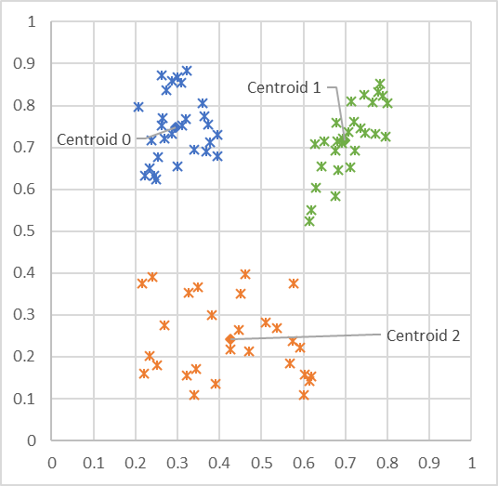
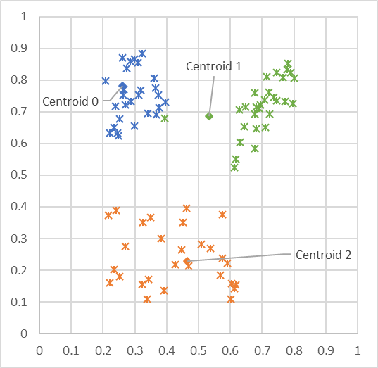
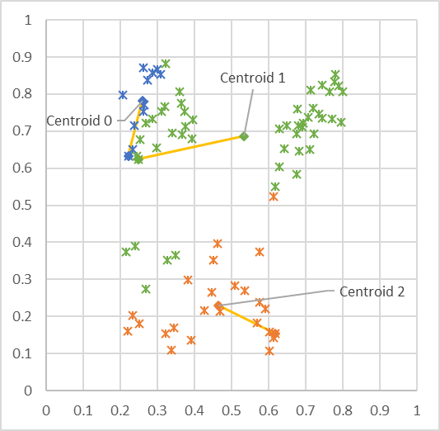
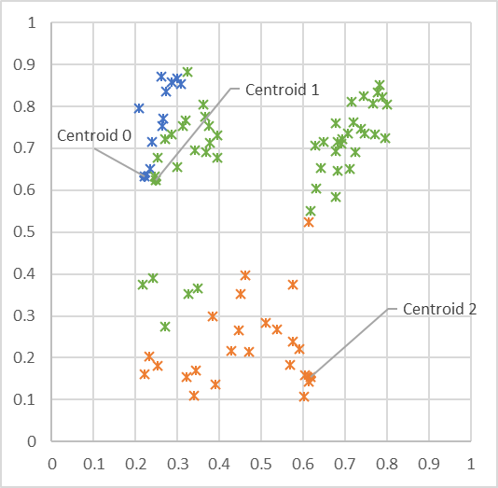
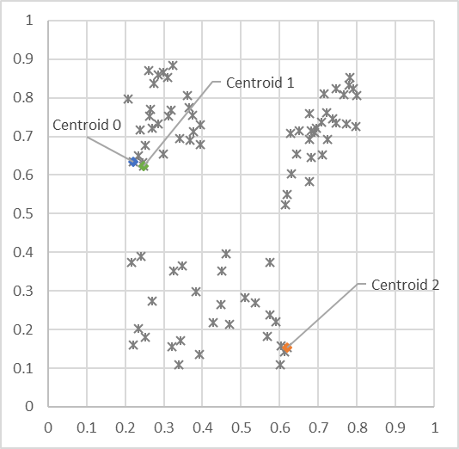
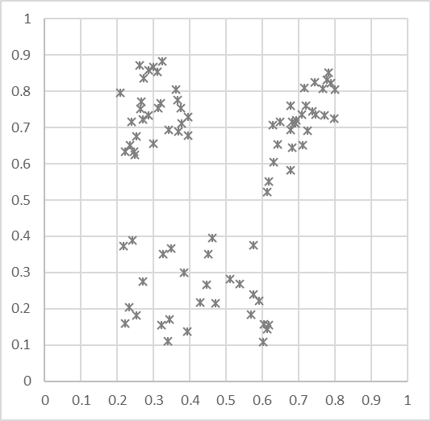


Visualizing K-Means
Unlabled Data
Initialize centroids to random data point locations
Each point assigned to nearest centroid
Update centroid locations to avg of assigned points
Each point assigned to nearest centroid
Update centroid locations to avg of assigned points
Each point assigned to nearest centroid
Converge!
L2 Norm = $\sqrt{d_{1}^{2}+ d_{2}^{2}}$

Slide 25
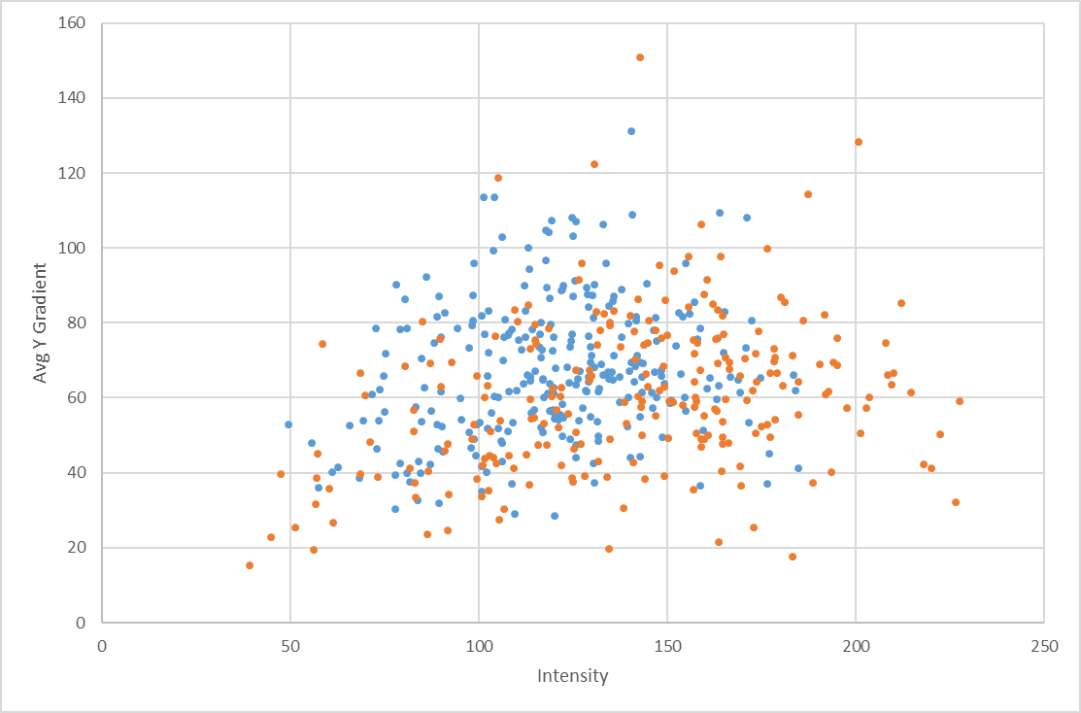
Instance Based Learning – K Nearest Neighbors
Classification technique that uses data as the model
K-Nearest Neighbors – K-NN
Model: the training data
Loss: there isn’t any
Optimization: there isn’t any
To apply, find the K nearest training data point to the test sample
Classify: predict the most common class among them
Probability: predict the distribution of their classes
def predict(xTest):
# for every sample in training set
# compute the distance to xText (using l2 norm)
# find the y values of k closest training samples
# return most common y among these values
# or the % that are 1 for a score…

Slide 26




Basic Neural Network Structure
Hidden Node
$$P(eyeOpened)$$
$$P(leftEye)$$
$$P(glasses)$$
576 Pixels
(Normalized)
$$P(child)$$
Input Layer
Hidden Layer
Output Layer

Slide 27

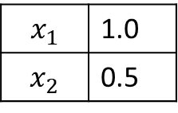
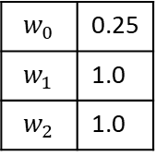
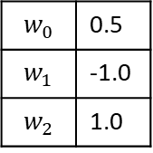
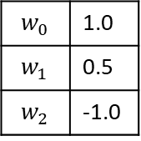
Example of Predicting with Neural Network
$$w_{0}$$ | 0.5
$$w_{1}$$ | -1.0
$$w_{2}$$ | 1.0
0.0
~0.5
$$x_{1}$$ | 1.0
$$x_{2}$$ | 0.5
1.5
$$P\left(y=1\right)=\sim 0.82$$
~0.75
1.0
$$w_{0}$$ | 0.25
$$w_{1}$$ | 1.0
$$w_{2}$$ | 1.0
$$w_{0}$$ | 1.0
$$w_{1}$$ | 0.5
$$w_{2}$$ | -1.0

Slide 28

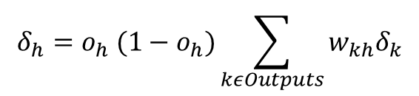
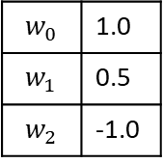

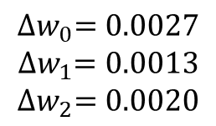

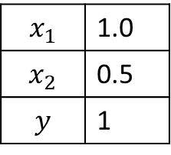
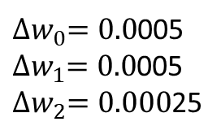


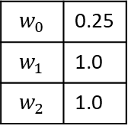


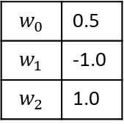


Backprop Example
Forward Propagation
Back Propagation
Update Weights
$$w_{0}$$ | 0.5
$$w_{1}$$ | -1.0
$$w_{2}$$ | 1.0
$$∝=0.1$$
$$δ_{h1}$$
$$δ_{o}=y^{^}(1−y^{^})(y−y^{^})$$
~0.5
$$δ_{o}=0.027$$
$$δ_{o}$$
~0.82
$$x_{1}$$ | 1.0
$$x_{2}$$ | 0.5
$$y$$ | 1
Error = ~0.18
$$w_{0}$$ | 0.25
$$w_{1}$$ | 1.0
$$w_{2}$$ | 1.0
~0.75
${∆w}_{i}=∝δ_{next}x_{i}$
$$δ_{h2}$$
${∆w}_{i}=∝δ_{next} x_{i}$
$$w_{0}$$ | 1.0
$$w_{1}$$ | 0.5
$$w_{2}$$ | -1.0
$${∆w}_{0}=0.0027$$
$${∆w}_{1}=0.0013$$
$${∆w}_{2}=0.0020$$
${∆w}_{0}=0.0$005
${∆w}_{1}=0.0$005
${∆w}_{2}=0.000$25
$$δ_{h}=o_{h} (1−o_{h})\sum_{kεOutputs}{w_{kh}δ_{k}}$$
$$δ_{h2}=.005$$

Slide 29
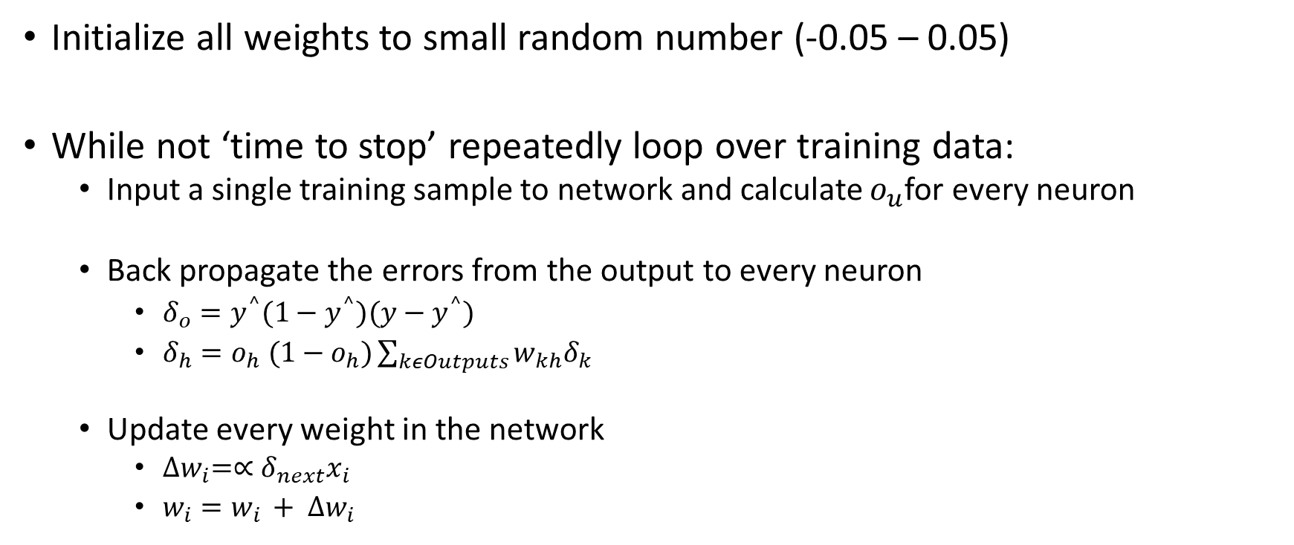
Backprop Algorithm
Initialize all weights to small random number (-0.05 – 0.05)
While not ‘time to stop’ repeatedly loop over training data:
Input a single training sample to network and calculate $o_{u}$for every neuron
Back propagate the errors from the output to every neuron
$δ_{o}=y^{^}(1−y^{^})(y−y^{^})$
$δ_{h}=o_{h} (1−o_{h})\sum_{kεOutputs}{w_{kh}δ_{k}}$
Update every weight in the network
${∆w}_{i}=∝δ_{next}x_{i}$
$w_{i}=w_{i }+ {∆w}_{i}$
Stopping Criteria:
# of Epochs (passes through data)
Training set loss stops going down
Accuracy on validation data

Slide 30
Neural Network Architectures/Concepts
Fully connected layers
Convolutional Layers
MaxPooling
Activation (ReLU)
Softmax
Recurrent Networks (LSTM & attention)
Embeddings
Residual Networks
Batch Normalization
Dropout

Slide 31
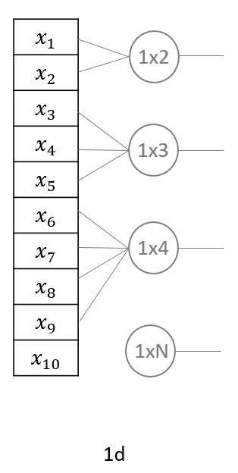
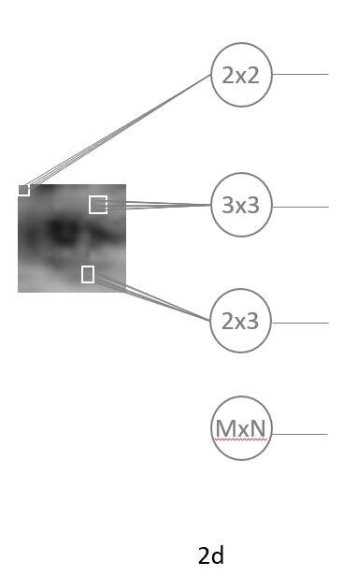
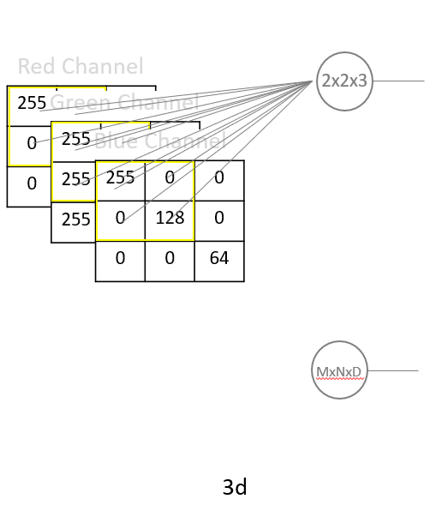
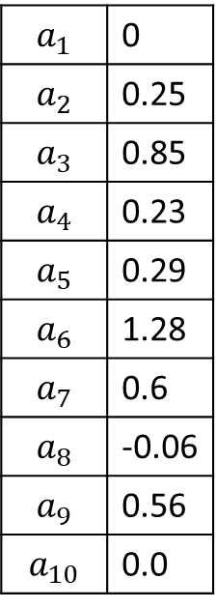
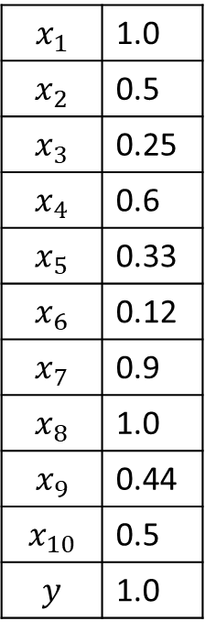
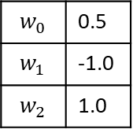
Convolutional Layer
$$x_{1}$$ | 1.0
$$x_{2}$$ | 0.5
$$x_{3}$$ | 0.25
$$x_{4}$$ | 0.6
$$x_{5}$$ | 0.33
$$x_{6}$$ | 0.12
$$x_{7}$$ | 0.9
$$x_{8}$$ | 1.0
$$x_{9}$$ | 0.44
$$x_{10}$$ | 0.5
$$y$$ | 1.0
$$a_{1}$$ | 0
$$a_{2}$$ | 0.25
$$a_{3}$$ | 0.85
$$a_{4}$$ | 0.23
$$a_{5}$$ | 0.29
$$a_{6}$$ | 1.28
$$a_{7}$$ | 0.6
$$a_{8}$$ | -0.06
$$a_{9}$$ | 0.56
$$a_{10}$$ | 0.0
$$w_{0}$$ | 0.5
$$w_{1}$$ | -1.0
$$w_{2}$$ | 1.0
Pad | 0.0

Slide 32
Backprop with Convolutional Layers
Forward Propagation
Back Propagation
Update Weights
Shared
Weights
$$w_{0}$$ | 0.5
$$w_{1}$$ | -1.0
$$w_{2}$$ | 1.0
$${∆w}_{0}=∝δ_{1,2}+ ∝δ_{2,3}+ ∝δ_{3,4}+ ∝δ_{4,p}$$
$$δ_{o}=y^{^}(1−y^{^})(y−y^{^})$$
$${∆w}_{1}=∝δ_{1,2}x_{1 }+ ∝δ_{2,3}x_{2 }+ ∝δ_{3,4}x_{3}+ ∝δ_{4,p}x_{4}$$
$$δ_{h}=o_{h} (1−o_{h})\sum_{kεOutputs}{w_{kh}δ_{k}}$$
$${∆w}_{2}=∝δ_{1,2}x_{2 }+ ∝δ_{2,3}x_{3 }+ ∝δ_{3,4}x_{4}$$
$$δ_{1,2}$$
${∆w}_{i}=∝δ_{next}x_{i}$
$$x_{1}$$ | 1.0
$$x_{2}$$ | 0.5
$$x_{3}$$ | 0.25
$$x_{4}$$ | 0.6
$$y$$ | 1.0
$$δ_{2,3}$$
$$δ_{o}$$
$$y^$$
$$δ_{3,4}$$
$$δ_{4,p}$$
Unrolled
1x2
Filter
Pad | 0.0
Convolutional Layer

Slide 33
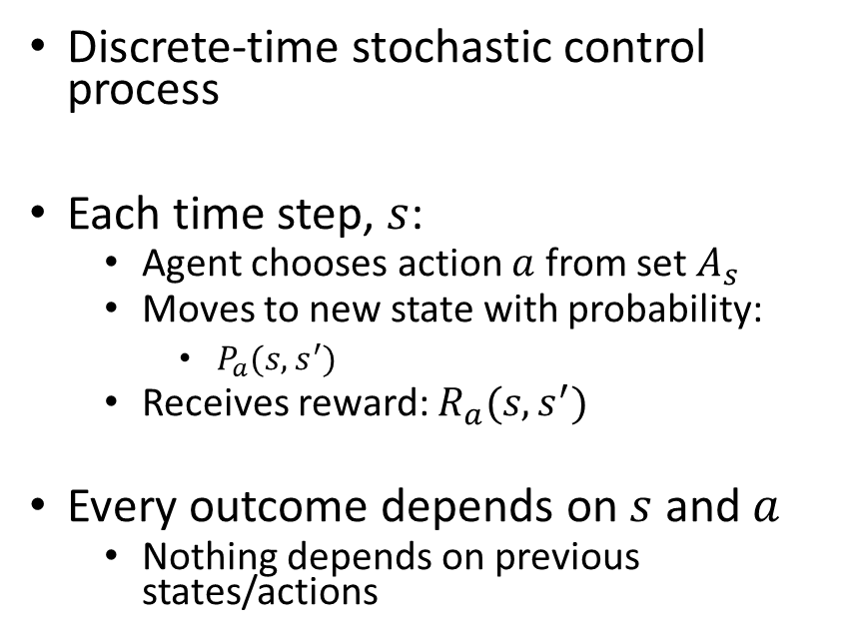
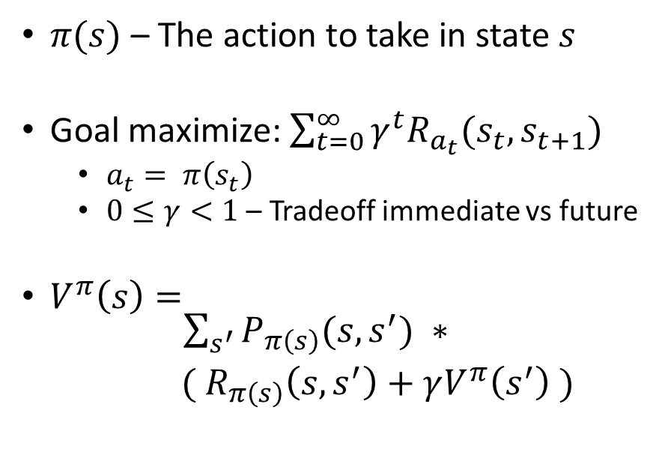
Reinforcement Learning
Agent
Reward
State
Action
Environment
Markov Decision Process (environment)
Policy
(agent’s behavior)
Discrete-time stochastic control process
Each time step, $s$:
Agent chooses action $a$ from set $A_{s}$
Moves to new state with probability:
$P_{a}(s, s^{′})$
Receives reward: $R_{a}(s, s^{′})$
Every outcome depends on $s$ and $a$
Nothing depends on previous states/actions
$π(s)$ – The action to take in state $s$
Goal maximize:$\sum_{t=0}^{∞}{γ^{t}R_{a_{t}}(s_{t},s_{t+1})}$
$a_{t}= π\left(s_{t}\right)$
$0≤γ<1$ – Tradeoff immediate vs future
$V^{π}\left(s\right)= \begin{matrix}\sum_{s^{′}}{P_{π\left(s\right)}(s,s^{′})} ∗ \\ ({ R}_{π\left(s\right)}\left(s,s^{′}\right)+γV^{π}\left(s^{′}\right) )\end{matrix}$

Slide 34




Q learning
Learn a policy $π(s)$ that optimizes $V^{π}\left(s\right)$for all states, using:
No prior knowledge of state transition probabilities: $P_{a}(s, s^{′})$
No prior knowledge of the reward function: $R_{a}(s, s^{′})$
Approach:
Initialize estimate of discounted reward for every state/action pair: $\hat{Q}\left(s,a\right)=0$
Repeat (for a while):
Take a random action $a$ from $A_{s}$
Receive $s^{′}$ and $R_{a}(s, s^{′})$ from environment
Update $\hat{Q}(s,a)$ = $(1−∝_{v}){\hat{Q}}_{n−1}(s,a)$ + $∝_{v}[{ R}_{a}\left(s, s^{′}\right)+γ\max_{a^{′}}{{\hat{Q}}_{n−1}\left(s^{′},a^{′}\right)} ]$
${ R}_{a}\left(s, s^{′}\right)+γ\max_{a^{′}}{{\hat{Q}}_{n−1}\left(s^{′},a^{′}\right)}$
$$∝_{v}= \frac{1}{1+visits(s,a)}$$
Exploration Policy: $P\left(a_{i},s\right)=\frac{k^{\hat{Q}(s,a_{i})}}{\sum_{j}{k^{\hat{Q}(s,a_{j})}}}$

Slide 35
Approaching your Intelligent System
Make sure an Intelligent System is right
Define what success looks like
Design Experience that achieves your goals
Plan for getting data from the user interactions
Plan to verify your intelligent experience
Decide where your intelligence will live
Design your intelligence runtime
Plan for intelligence management
Plan for telemetry
Prepare to evaluate your intelligence
Decide how you will organize your intelligence
Set up your intelligence creation process
Plan for orchestration throughout your Intelligent System's lifecycle
Prepare to identify and deal with mistakes
Get ready for abuse
Have fun and change the world...
Notes:
Thanks for listening. We covered Intelligent Systems, and why you might need one. Then we talked about closed-loop intelligence and the five factors to balance to keep an Intelligent System successful: the objective, experience, implementation, intelligence, and orchestration.
There is much more I wish I had time to share. And if you want more details you can check out my book on Building Intelligent Systems. You can also contact me at ghulten@intelligentsystem.io. I want to leave you with a checklist for approaching your own Intelligent System project, some of these we talked about today, and some we didn’t.
And I think, most important is number 16 -- have fun. AI and machine learning are changing the world, and it’s an exciting time to be involved.

Slide 36
Thank you!
Keep in touch: ghulten@hotmail.com or on LinkedIn
A few requests:
Let me know if you end up doing ML in practice
Send me constructive criticism on the course

